Slide 1
Final Game: TREASURE RUN

Slide 2
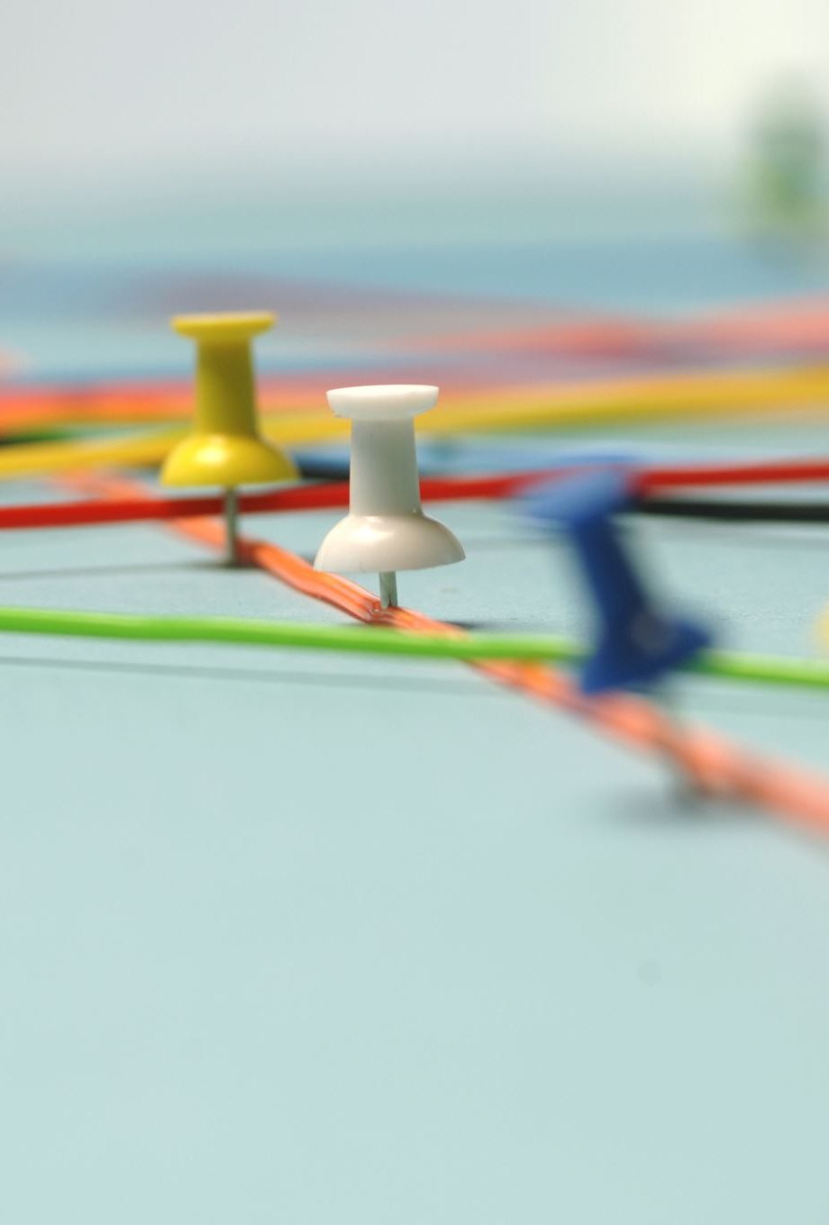
IDEA
Original idea: obstacle course or race with a start position and end position
Create coins throughout the map for scoring and competition
Character moves through course and tries to get to the finish line before the timer runs out
2 levels:
Level 2 is harder, and gives user less time to complete the course

Slide 3
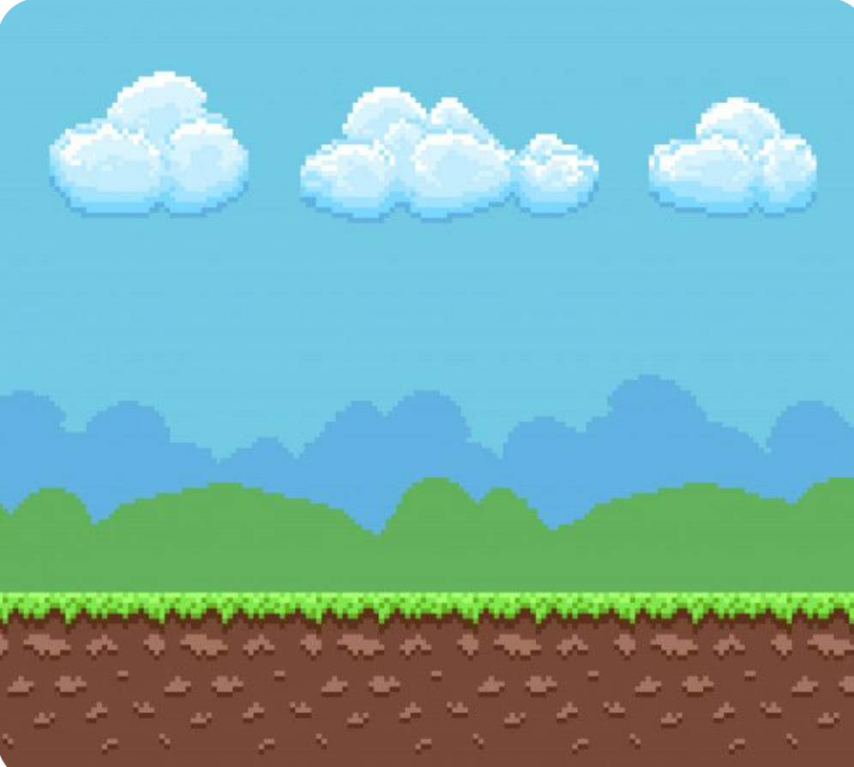

IMAGES
Background and platform:
Originally, I used a background with platforms already drawn into them. However, on day 3, I changed it to a regular landscape background and just added the platforms in. This made it easier to do the collide points with the character’s hitbox.
Platform
Background

Slide 4


IMAGES (continued)
Coins and Treasure:
I added generic coins around the map for the user to attempt to get. I also added a treasure chest in the bottom right corner of the screen to signify the finish and final position of the course.
Treasure Box
Coin

Slide 5
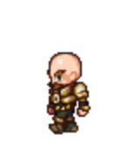
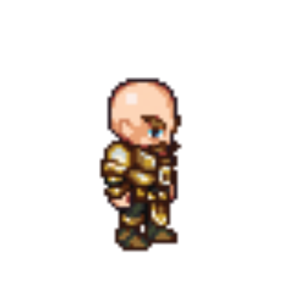
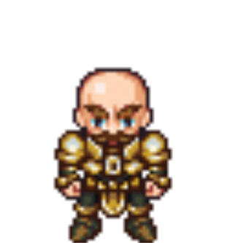
IMAGES (continued)
Character:
I used the character that someone used in a youtube tutorial on character animations. I used multiple images to animate the walking left, walking right, and standing places of the character.
Character walking left
Character standing idle
Character walking right

Slide 6
References
Creating a timer (I created a timer within each level to challenge the user) - https://www.youtube.com/watch?v=YOCt8nsQqEo
Scaling images (I scaled all of my images other than the character) - https://stackoverflow.com/questions/20002242/how-to-scale-images-to-screen-size-in-pygame
Collidepoints and hitboxes (made a hitbox for the character, and collidepoints with the coins, treasure, and platforms- https://www.youtube.com/watch?v=1aGuhUFwvXA&t=42s
Character animation (I used some of the code from this one) - https://www.techwithtim.net/tutorials/game-development-with-python/pygame-tutorial/pygame-animation/
Removing background from images - https://www.adobe.com/express/spotlight/image/remove-background?sdid=NLMHR9T3&mv=search&ef_id=Cj0KCQjwntCVBhDdARIsAMEwACnFGZKRW2lACStbOELnglq6wyC00qXdVm_3RjzTHGza4zmbxqZAafgaAkCdEALw_wcB:G:s&s_kwcid=AL!3085!3!571670982430!e!!g!!remove%20background!15566817525!133997425391
How to hide the hitbox of coins after the character collects them (hiding it and making it transparent) -https://www.reddit.com/r/pygame/comments/di5dhp/how_to_hide_images/

Slide 7
Setbacks
I had to change my background halfway through the game in order to create rectangles as platforms that would be collidepoints for the character’s hitbox.
On Thursday, I had to rework my game because I couldn’t figure out the collide points of the platforms, so I replaced the platforms with spikes. Now, the objective was to avoid the spikes. I figure out how to make the collidepoint of the spikes to send the character back to the starting position.

Slide 8
Achievements
Getting the menu to run smoothly and effectively
Creating collidepoints for every image, and successfully utilizing them in the game
Getting the game to run the way I wanted to. This was achieved through a lot of problem solving and adaptations to problems

Slide 9
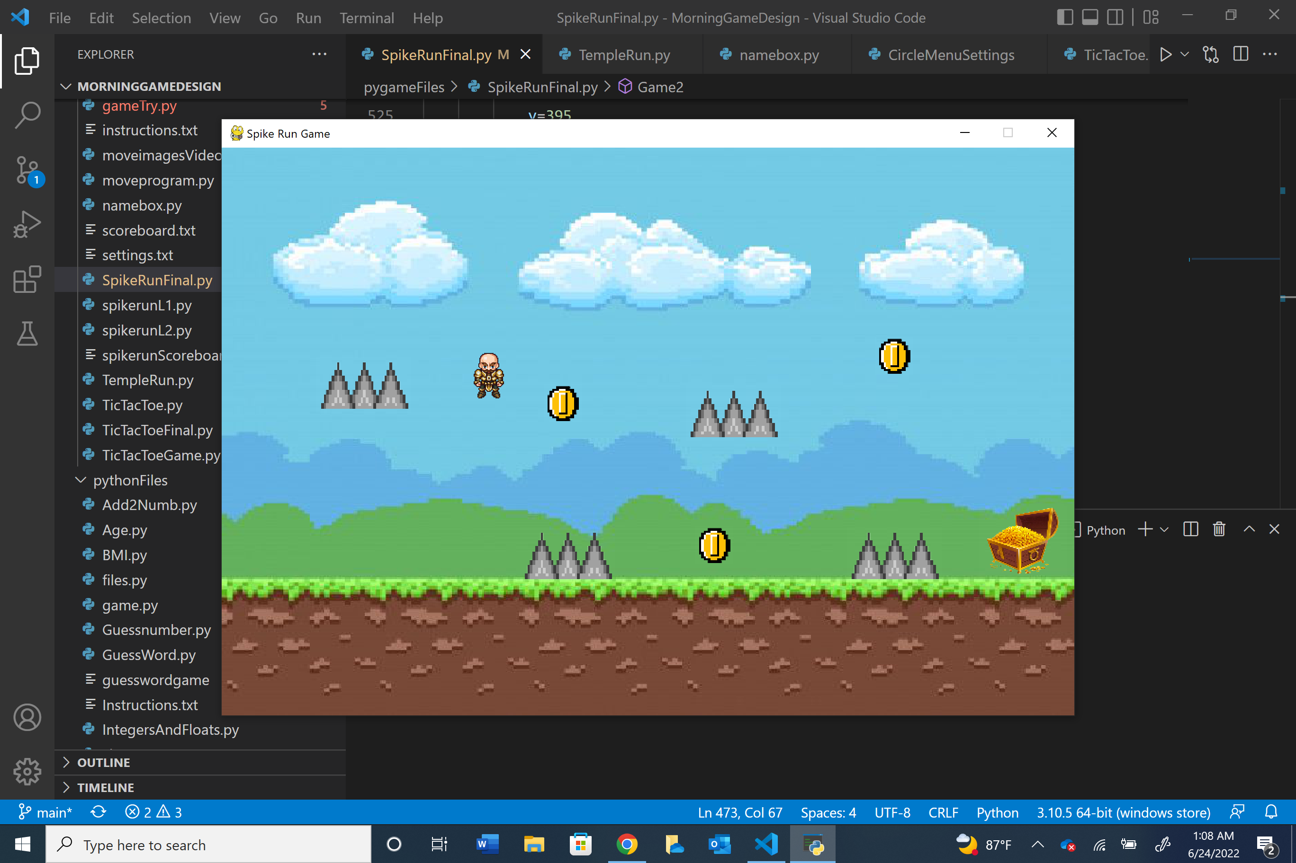
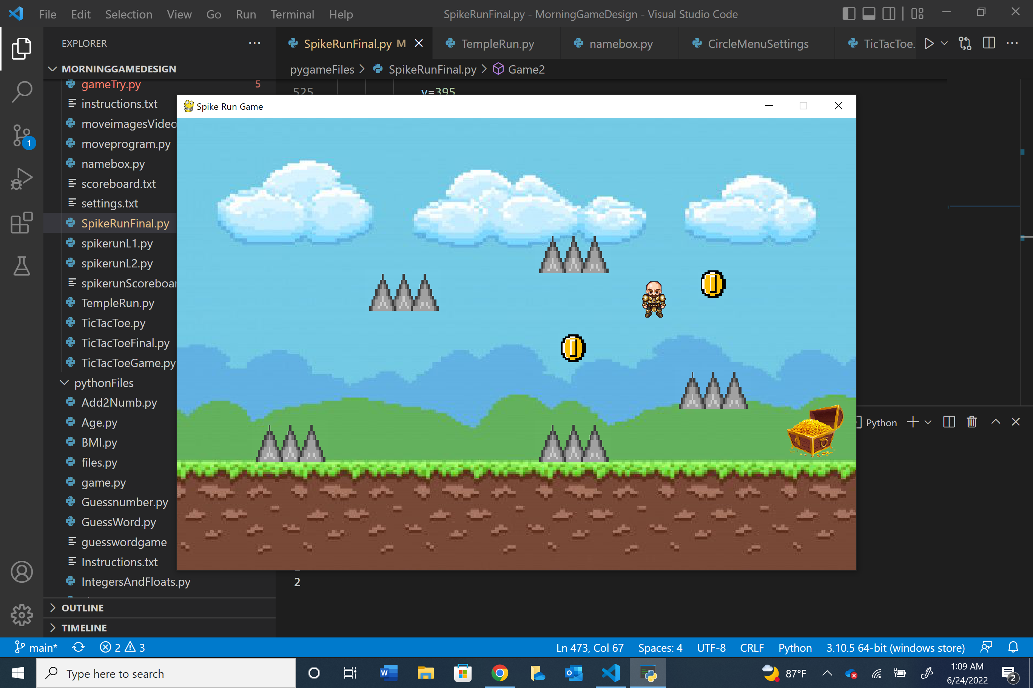
Game Running
Level 1
Level 2

